Slide 1
Live Data Collection
Windows Systems

Slide 2
COMPUTER SECURITY INCIDENT
DEFINE
WHY NECESSARY
WHO IS INVOLVED IN PROCESS
METHODOLOGY

Slide 3
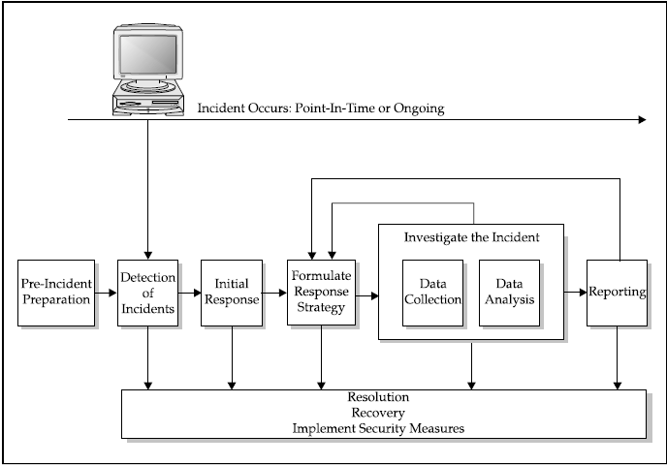
INCIDENT RESPONSE COMPONENTS

Slide 4
Topics
■
Live Investigation Goals
Creating a Response Toolkit
Common Tools and Toolkits Preparing the Toolkit
Storing Information Obtained During the Initial Response
Transferring Data with Netcat
Integrity with md5sum
■
Encrypting Data with Cryptcat
Volatile Data for Live Response
Investigation Organizing and Documenting
Collecting Volatile Data, 10 Steps
In Depth Live Response
Obtaining Event Logs during Live Response
System Passwords
■
■
■
■
■
■
■
■
■
■
■
■

Slide 5
Live Investigation Goals
■
Obtain enough information to determine appropriate response.
Considerations include totality of the circumstances
Learn before responding
Two goals:
Confirm there is an incident
Retrieve volatile system data
■
❑
■
•
Won’t be there after system powered off

Slide 6
Creating a Response Toolkit
Without affecting any potential evidence, plan to obtain all relevant information.
By collecting trusted files on a CD, you are better equipped to respond:
■
■
■
Quickly Professionally Successfully
■
■

Slide 7
Some Common Tools and
Sources
■
Cmd.exe PsLoggedOn
■
md5sum etree.org
rmtshare NTRK
■
SysInt
■
■
rasusers netstat fport FS
NTRK
■
netcat cryptcat
atstake sourceforge
■
■
■
■
PsLogList FS
ipconfig
■
PsList SysInt ListDLLs FS nbstat
arp
kill NTRK
■
■
■
PsInfo PsFile
SysInt SysInt
■
■
■
■
PsService SysInt auditpol NTRK doskey
■
■
■

Slide 8
Tool Interface Categories
Since GUI programs create windows, have pull down menus, and generally do “behind the scenes” interaction, the text authors advise against using them during an investigation.
■
Graphical or command line
❑
GUI or CLI
■

Slide 9
Preparing the Toolkit
■
Label response toolkit media with:
❑
Case number Time and date
Name of investigator Presence of output files?
❑
❑
❑
■
Check for dependencies (Filemon) Create toolkit checksum
Write protect any toolkit floppies
■
■

Slide 10
Storing Information Obtained
During the Initial Response
■
■
Live refers to a currently powered on system. Environment untrusted
Unexpected should be anticipated.
❑
Four options
Save the retrieved data to a hard dive
Record data in a notebook by hand
Save data onto the response floppy disk
Or other removable storage medium
Save data on a remote system using net or cryptcat
•

Slide 11
Transferring Data with Netcat
■
Netcat can create a connection between the target system and the forensic workstation
❑
Allows you to review information offline
■
After the data transfer is complete, you will need to break the connection.
❑
On the forensic workstation, press CTRL-C.

Slide 12
Integrity with md5sum
■
Protect the integrity of retrieved files.
Among other places, you can get md5sum for windows from etree.org
Perform the md5sum in the front of witnesses.
❑
■
Process Summary
■
Run trusted commands on NT Server Send output to forensics box with NetCat Md5sum files
Perform off-line review
■
■
■

Slide 13
Encrypting Data with
Cryptcat
■
Cryptcat has the same syntax and functions as netcat
❑
Encrypted data transfer.
Encrypting files means that:
■
Attacker’s sniffer cannot compromise your information (Unless your passphrase is compromised.)
Encryption nearly eliminates risk of data contamination or injection
■

Slide 14
Volatile Data for Live
Response
Only available prior to system power off.
Possible data items include:
■
System date and time Currently logged on users
Time/date stamps for entire file system Currently running processes Currently open sockets
Applications listening on open sockets
Systems that have current or recent connections to the system
■
■
■
■
■
■

Slide 15
Investigation Organization and
Documentation
Two reasons to document
Gather information that may become evidence
Protect organization
Notes
■
Before starting, create tool hashes
Use a form to plan and document response.
Good policy to have a witness sign the form and verify each MD5 sum.
■
■

Slide 16
Collecting Volatile Data
Execute trusted cmd.exe
Record system time and date
Determine logged users
For all files, record modification, creation, and access times.
Determine open ports.
List applications associated with open ports
List all running processes
List current and recent connections
Document commands used during initial response.

Slide 17
Gathering Data One
■
For all files, record modification, creation, and access times
❑
Dir
■
Determine open ports
❑
Fport
■
Enumerate all running processes on the target system
❑
PsList
Note, to identify abnormal processes, you first need to have identified normal processes i.e. done a baseline.

Slide 18
Gathering Data Two
Netstat can determine current connections as well as the remote IP address of those connections
Arp cache contains IP addresses mapped to MAC addresses
Use nbtstat to access the remote NetBIOS name cache
■
List current and recent connections
❑
■
■

Slide 19
Gathering Data Three
Use:
doskey /history
to display the command history of the current command shell

Slide 20
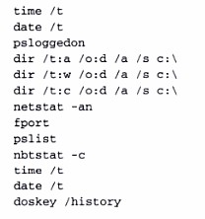
Scripting Initial Response
■
Many technical steps performed during the initial response can be incorporated into a batch script.
For example, ir.bat from Mandia, page 114.
■

Slide 21
In Depth Live Response
■
Date and time commands PsLoggedOn
Netstat
PsList Fport
Safeback or EnCase.
■
■
■
■
■

Slide 22
In Depth Response Tools
■
Auditpol NTRK
Reg NTRK
Regdump NTRK
Pwdump3e NTLast FS Sfind FS Afind FS Dumpel NTRK
■
■
■
■
■
■
■

Slide 23
Collecting Live Response
Data
■
Review
❑
Event logs Registry
❑
■
Obtain system passwords Dump system RAM
■

Slide 24
Obtaining Event Logs during Live
Response
Auditpol discovers which audit policies exist
NTLast allows you to monitor successful and failed system logons
Dumpel can retrieve remote logs
■
■
■

Slide 25
Live Response: Reviewing the
Registry
■
Regdump creates an enormous text file from a registry.
■
Reg query extracts just the Registry key values of interest

Slide 26
System Passwords
Use pwdump3e to dump the passwords from the SAM file
Crack them with John or similar tool or Use Rainbow tables
You may also want to dump system RAM
■
■
■
■

Slide 27
Decide
■
Forensic duplication necessary?

Slide 28
Questions?

Slide 29
Live Data Collection from
Unix Systems

Slide 30
Topics
■
Creating a Response Toolkit
Storing Obtained Information
Obtaining Volatile Data Prior to Forensic Duplication
Data to Collect
■
Unix File Deletion
Executing a Trusted Shell
Gathering Info
■
■
■
■
■

Slide 31
Intro
Unix allows the deletion of a program after it executes.
Many Unix variants are neither backwards nor forwards compatible.
■
■

Slide 32
Creating a Response Toolkit
Many Unix distributions requires their own unique toolkit.
Prior to incident, create response toolkits. Only use trusted commands.
■
■
■

Slide 33
Storing Information Obtained
During the Initial Response
■
Options include:
❑
Local hard drive Remote media
Record information by hand
For digital transport, use netcat or cryptcat
❑
❑
❑

Slide 34
Best Time
■
After selecting how you will retrieve data from the target system, you must consider the optimum time to respond

Slide 35
Obtaining Volatile Data Prior to
Forensic Duplication
■
Volatile data includes:
❑
Currently open sockets Running processes Contents of system RAM Location of unlinked files.
❑
❑
❑
■
Unlinked files are files marked for deletion when the processes that access them terminate.

Slide 36
Data to Collect
■
System date and time Users currently logged on
Time/date stamps for the entire files system Currently running processes
Currently open sockets
Applications listening on open sockets
Systems that have current or recent system connections
■
■
■
■
■
■

Slide 37
Sample Data Collection
Process
Execute trusted shell
Record system time and date
Determine who is logged on
Record modification, creation, and access times of all files
Determine open ports
List applications associated with open ports
Determine running processes
List current and recent connections
Record the system time
Record the steps taken
Record cryptographic checksums

Slide 38
Unix File Deletion
■
Unix tracks a file’s link count
Positive integer represents the number of processes currently using the file
When link count equals zero, it means that no process is using or needs the file. So it will be deleted.
When an attacker deletes his rogue program:
Program on the hard drive is removed from the directory chain,
Link count is decremented by one, and
File’s deletion time is set.
Note, link count does not equal zero until process terminates.
❑
■
■
■

Slide 39
Executing a Trusted Shell
Console mode Windows (GUI)
Exit XWindows before you initiate response.
Log on locally at the victim console to avoid generating network traffic
Be sure to log on with root level privileges
Two Unix modes
1.
2.
■
■
❑
Mount trusted device e.g. for a floppy
mount /dev/fd0 /mnt/floppy

Slide 40
Gathering Info
■
Record System Date and Time
❑
Date command
■
Determine who is logged on
❑
Who command

Slide 41
Gather File Info
■
Record file modification, access, and Inode change times. For example:
ls –alRu ls –alRc ls –alR
/ > /floppy/atime
/>
/floppy/ctime
/ > /floppy/mtime

Slide 42
Ports and Processes
■
Ports netstat –an Processes netstat –anp
Note, average Unix system has many more processes running than Windows system.
Processes
ps command
■
■
■

Slide 43
Checksums
■
Record checksums of all recorded files Consider scripting initial response
■

Slide 44
Live Response In Depth
■
Use dd, cat, netcat, and des, or crypt cat to obtain log files, configuration files and any other relevant files.
Rootkits freely available.
Most advanced rootkits are loadable kernel modules (LKMs)
Unix kernel is a single program
LKMs are programs that can be dynamically linked into the kernel after the system has booted up
■
❑
■
■
❑
Rogue LKMs installed by attackers can intercept system commands such as netstat, ifconfig, ps, and ls and create false results
Can also hide files and/or process as well as create back doors
❑

Slide 45
Obtaining the System Logs
During Live Response
Most Unix flavors keep their log files in /var/adm or / var/logsubdirectories
Log files can be obtained with a combination of netcat, cryptcat, dd, and des
Interesting logs
■
■
■
❑
Utmp Wtmp Last log
❑
❑
■
Process accounting logs
❑
/etc/syslog.comf

Slide 46
Sample Configuration Files
/etc/passwd
/etc/shadow
/etc/groups
/etc/hosts
/etc/hosts.equiv
More
cited
in text(see
Mandia
p.141)

Slide 47
Discovering Illicit Sniffers
■
A sniffer can increase an attack’s severity. Also indicates attacker had root privileges
■

Slide 48
Reviewing the /Proc File System
■
On many Unix distros, the /proc file system is a pseudo-file system used as an interface to kernel data structures.
❑
By changing in to /proc, you are really accessing kernel data structures, rather than a conventional directory.
Each process has a subdirectory in /proc the corresponds to its PID.
❑

Slide 49
The Exe Link in the /Proc File
System
The exe link allows investigators to recover deleted files as long as they are still running.
By examining the fd (file descriptor) subdirectory, you can identify all of the files a process has open.
■
■

Slide 50
Dumping System RAM
■
Traditionally a challenging process.
Usually transfer the /proc/kmem file from the target system
File contains the contents of system RAM in a non-contiguous arrangement.
■
■

Slide 51
Questions?

